Slide 1
Object detection in images/videos using detr transformer model

Slide 2
CONTENTs
1. Introduction to Object Detection
2. Evolution and Applications
3. Introduction to DETR
4. How DETR Works
5. Recent Advances in DETR
6. Setting Up DETR Model
7. Object Detection and Visualization

Slide 3
Introduction to Object Detection
Object detection is a computer vision task that involves identifying and locating objects within images and videos. It extends beyond simple image classification by not only determining the presence of objects but also drawing bounding boxes around them. This capability is crucial for various applications, including autonomous driving, surveillance, and image retrieval.
Applications: Autonomous driving, security surveillance, and retail inventory management are examples where object detection is used extensively

Slide 4
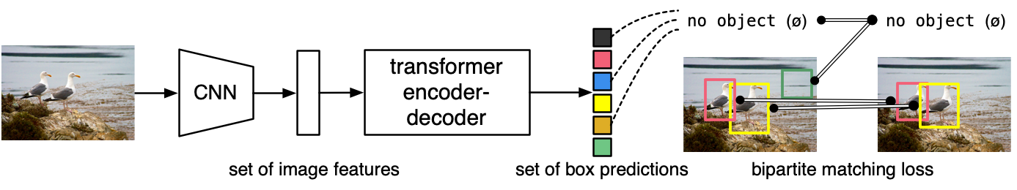
Introduction to DETR
DETR, which stands for DEtection TRansformer, is a state-of-the-art object detection model introduced by Facebook AI Research. Unlike traditional methods that rely heavily on predefined anchor boxes and region proposals, DETR leverages Transformer models, which were originally designed for language processing tasks

Slide 5
How DETR Works
DETR treats object detection as a direct set prediction problem. It uses a Transformer architecture to model relationships between objects and their contextual information within an image. The model outputs a set of bounding boxes and class labels, which are then used to identify objects.
Recent Advances in DETR:
Recent versions of DETR have improved its initial design to address limitations in speed and accuracy. Enhancements include incorporating a more refined architecture, better training strategies, and optimizing for performance on larger datasets. These updates have made DETR a powerful tool for real-time object detection tasks, improving its applicability in various real-world scenarios.

Slide 6
Setting Up DETR ModeL
!pip install -i https://test.pypi.org/simple/ supervision==0.3.0 –user
!pip install transformers --user
!pip install pytorch-lightning --user
!pip install roboflow --user
!pip install timm --user
Description :

Slide 7
Load Model
import torch from transformers
import DetrForObjectDetection,DetrImageProcessor
device=torch.device('cuda:0' if torch.cuda.is_available() else cpu') checkpoint='facebook/detr-resnet50’
confidence_threshold=0.4
iou_threshold=0.8 image_processor=DetrImageProcessor.from_pretrained(checkpoint) model=DetrForObjectDetection.from_pretrained(checkpoint)
model.to(device)
Description :
This section of the code is focused on importing necessary libraries, configuring device settings, and initializing the DETR model and its associated components

Slide 8
Performing Object Detection and Visualizing Results
import cv2
import torch
import supervision as sv
with torch.no_grad():
image=cv2.imread('/content/imageexpo2.jpg’)
inputs=image_processor(images=image,return_tensors='pt').to(device)
outputs=model(**inputs)
target_sizes=torch.tensor([image.shape[:2]]).to(device) results=image_processor.post_process_object_detection(outputs=outputs,target_sizes=target_sizes)[0]
detections=sv.Detections.from_transformers(transformers_results=results)
labels[f{model.config.id2label[class_id]}{confidence_threshold:0.2f}"
for _,_,class_id,_ in detections ]:
box_annotator=sv.BoxAnnotator()
frame=box_annotator.annotate(scene=image,detections=detections,labels=labels )
%matplotlib inline sv.show_frame_in_notebook(frame,(16,16))
Description: This section of the code is focused on reading an image, performing object detection using the DETR model, and then annotating and displaying the results.

Slide 9
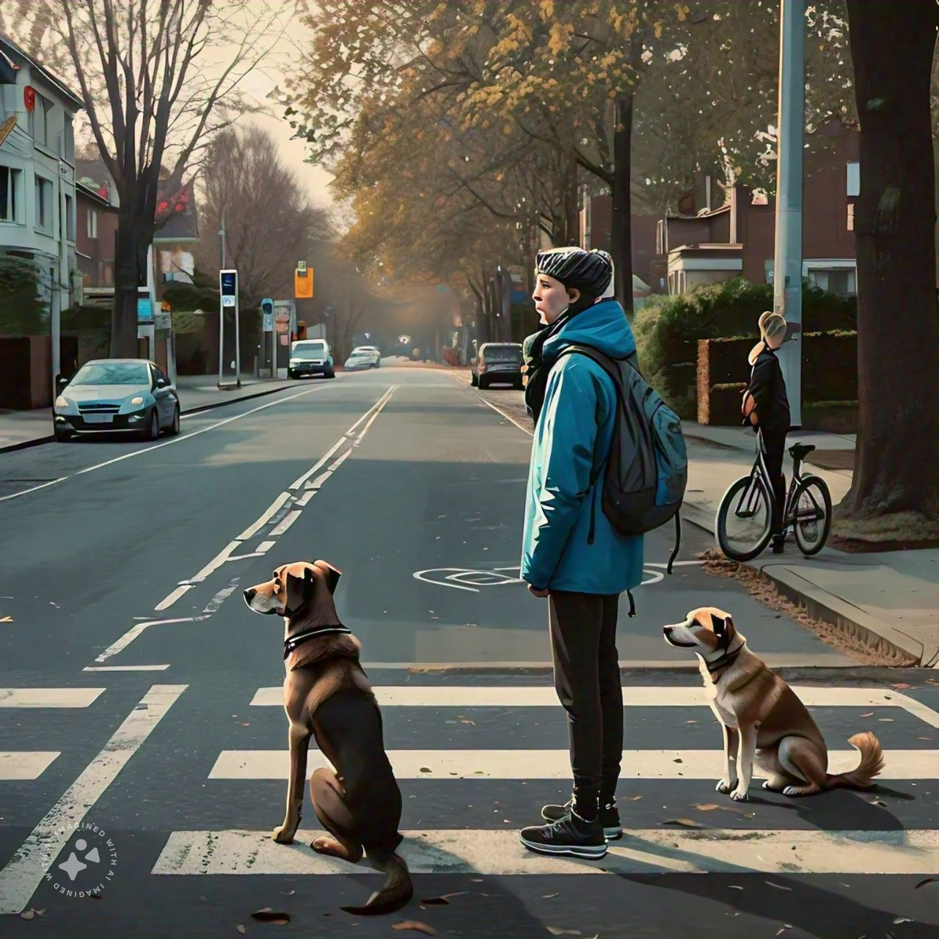
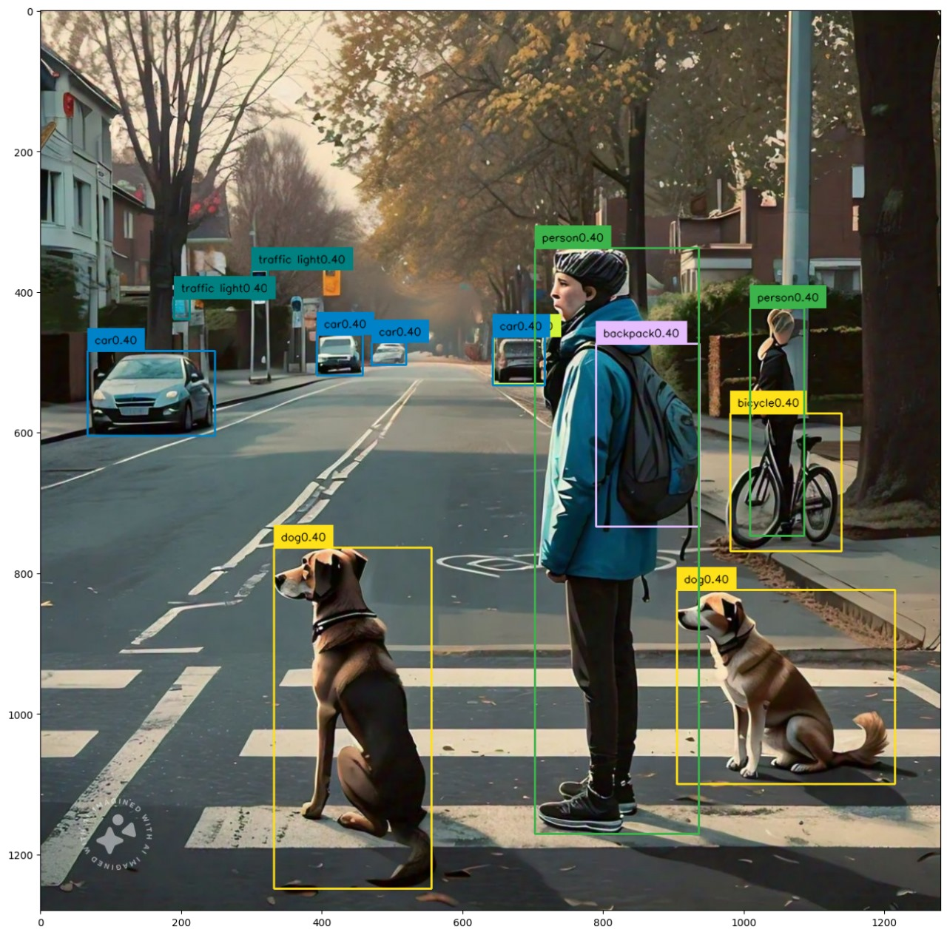
Input image
Output image

Slide 10
THANK YOU

